Slide 1
Special forms of square matrices- Sparse, Polynomial

Slide 2
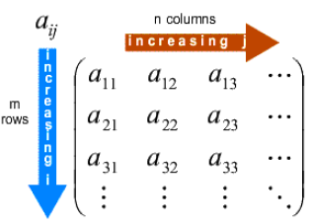
2-Dimensional Arrays
Matrices
A m x n matrix is a table with m rows and n columns (m and n are the dimensions of the matrix)
Operations: addition, substraction, multiplication, transpose, etc.

Slide 3
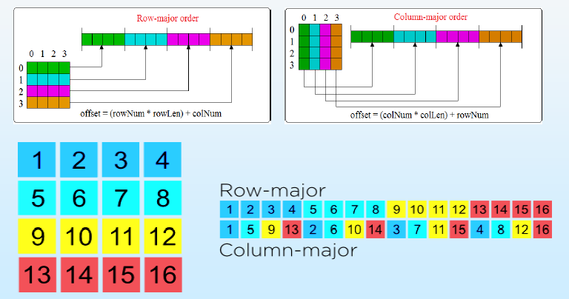
Matrices (Continued …)
Representations (mapped as 1-D array)

Slide 4
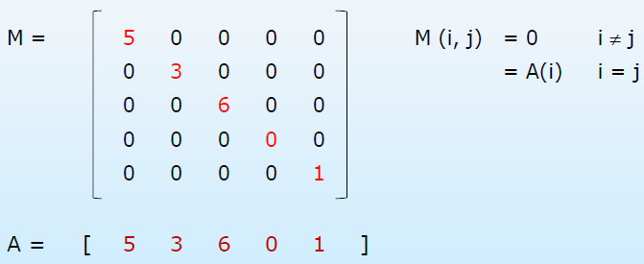
Special forms of square matrices (m = n)
Diagonal: M (i, j) = 0 for i ≠j
Diagonal entries = m

Slide 5
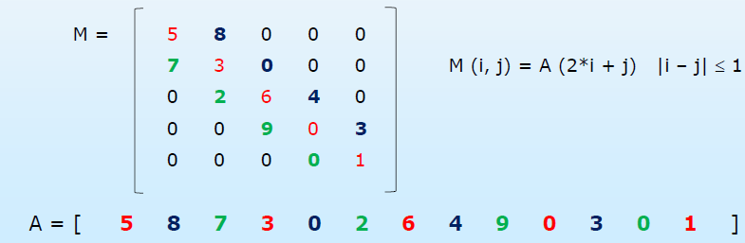
Special forms of square matrices (m = n)
Tridiagonal: M (i, j) = 0 for | i –j | > 1
3 diagonals: Main →i = j; Lower →i = j +1; Upper →i= j -1
Number of elements on three diagonals: 3*m-2
Mapping: row-major, column-major or diagonals (begin with lowest)

Slide 6
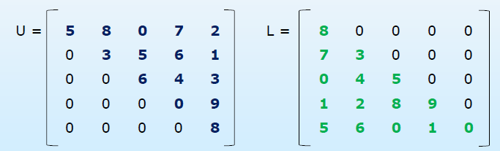
Special forms of square matrices (m = n)
Triangular matrices
No. of elements in non-zero region: n (n + 1) / 2
Upper triangular: M (i, j) = 0 for i>j
Lower triangular: M (i, j) = 0 for i<j
Upper: M (i, j) = A ((n * i) + j –(i* (i+ 1) / 2)) for i ≤ j
Lower: M (i, j) = A (i* (i+ 1) / 2 + j) for i ≥ j

Slide 7
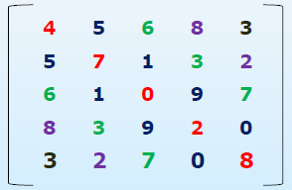
Special forms of square matrices (m = n)
Symmetric: M (i, j) = M (j, i) for all i and j
Can be stored as lower-or upper-triangular
E.g., Table of inter-city distance for a set of cities
2-Dimensional Arrays

Slide 8
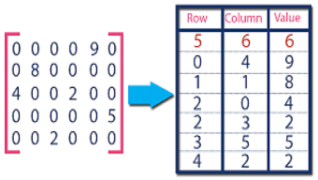
Sparse Matrices
Sparse matrices
Number of non-zero elements is very less compared to total number of elements
Represented as a 1-D array of triplets
Element 1 onwards -Row, Column and Value –for all non-zero elements
Element 0 –number of rows, columns and non-zero elements

Slide 9
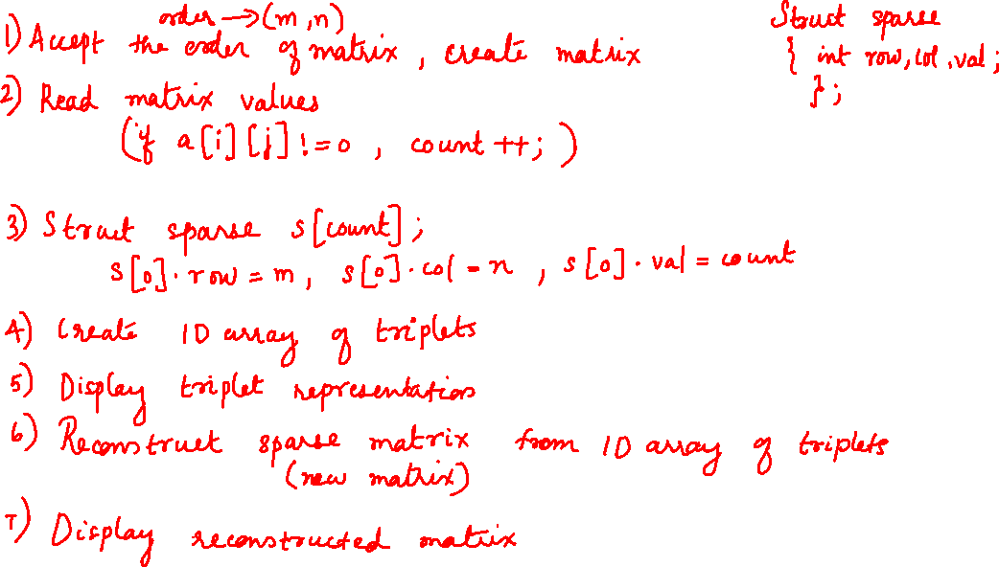

Slide 10
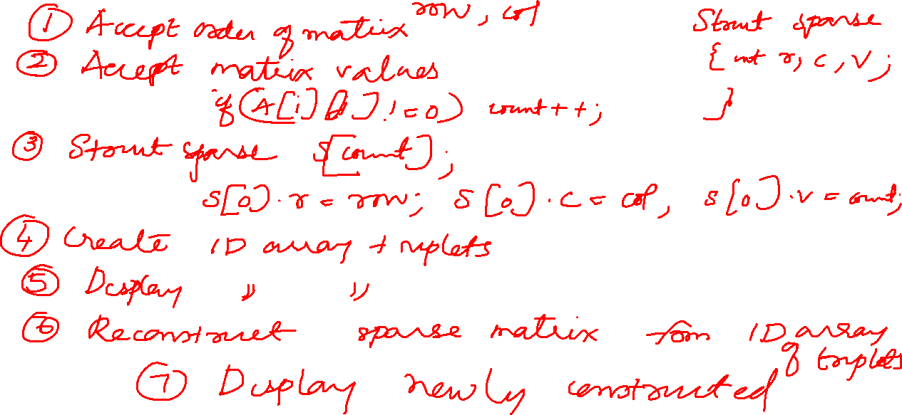

Slide 11
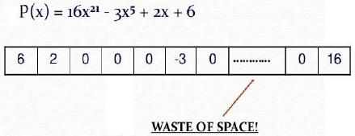
Polynomials
Polynomial
An expression of the form
a_{n}x^{n}+ a_{(n-1)}x^{(n-1)}+ … + a₁x¹+ a₀
One possible way of representation
Store coefficients of the terms in an array element at position equal to the exponent
Disadvantage: Waste of space specially in case of sparse polynomial

Slide 12
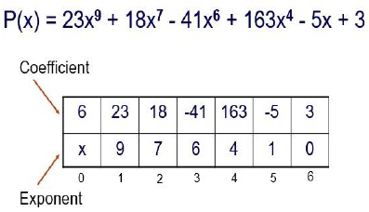
Polynomial(Continued …)
Represented as a 1-D array of doublets
Element 1 onwards -coefficient and exponent of all terms
Element 0 –number of terms (either in coefficient or exponent field)

Slide 13
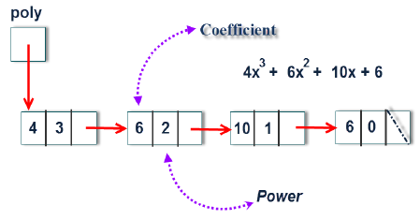
Polynomial(Continued …)
Represented as a linked list
Store the coefficient and exponent (power) of each term in a node of a singly linked list

Slide 14
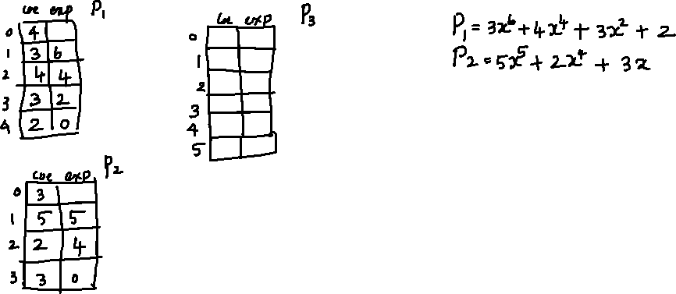


Slide 15
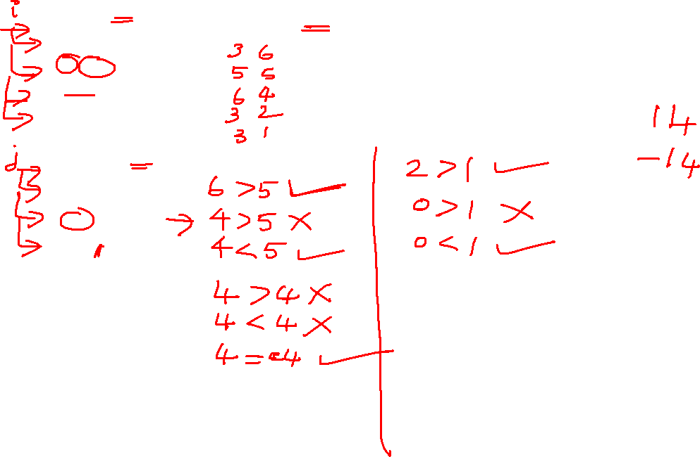

Slide 16
int main()
{
poly p1[10],p2[10],p3[20];
printf("1st polynomial:\n");
getpoly(p1);
printf("\n2nd polynomial:\n");
getpoly(p2);
printf("\n1st polynomial: ");
showpoly(p1);
printf("\n2nd polynomial: ");
showpoly(p2);
add(p1,p2,p3);
printf("\nSum : ");
showpoly(p3);
printf("\n");
return 0;
}
//add polynomial as 1d array
#include <stdio.h>
typedef struct
{
int coeff, exp;
} poly;

Slide 17
void getpoly(poly p[])
{
int n,i;
printf("Enter the number of terms: ");
scanf("%d",&n);
printf("Enter the terms (coefficient, exponent):\n");
p[0].coeff=n;
for(i=1;i<=n;i++)
scanf("%d %d",&p[i].coeff,&p[i].exp);
}
void showpoly(poly p[])
{
int i;
for(i=1;i<=p[0].coeff;i++)
printf("(%d,%d) ",p[i].coeff,p[i].exp);
}

Slide 18
void add(poly p1[],poly p2[],poly p3[])
{
int i=1,j=1,n1=p1[0].coeff,
n2=p2[0].coeff,n3=0;
while(i<=n1 && j<=n2)
{
if(p1[i].exp>p2[j].exp)
{
n3++;
p3[n3].coeff=p1[i].coeff;
p3[n3].exp=p1[i].exp;
i++;
}
else if(p1[i].exp<p2[j].exp)
{
n3++;
p3[n3].coeff=p2[j].coeff;
p3[n3].exp=p2[j].exp;
j++;
}
while(i<=n1)
{
n3++;
p3[n3].coeff=p1[i].coeff;
p3[n3].exp=p1[i].exp;
i++;
}
while(j<=n2)
{
n3++;
p3[n3].coeff=p2[j].coeff;
p3[n3].exp=p2[j].exp;
j++;
}
p3[0].coeff=n3;
}
else {
int sum=p1[i].coeff+p2[j].coeff;
if(sum!=0)
{
n3++;
p3[n3].coeff=sum;
p3[n3].exp=p1[i].exp;
}
i++;
j++;
}
}

